Slide 1


NurseLIFT
NurseLIFT is a digital health concierge that uses AI
to find, recommend & deliver the best consumer health & wellness resources to any nurse based on their unique problems & unmet needs.
TEAM 17 NurseLIFT

Slide 2



PROBLEM STATEMENT
“I don’t know where
to go, how to start or what’s most important.”
MARKETPLACE
GOOGLE!
Burnout
VIDEOS – 90M+
WEARABLES – 700+
APPS – 400K+
COMMUNITIES
EVENTS
SERVICES
PRODUCTS
Turnover
Poor Outcomes
Unhealthy Lifestyle
Social Isolation
KELLY
COVID-19

Slide 3

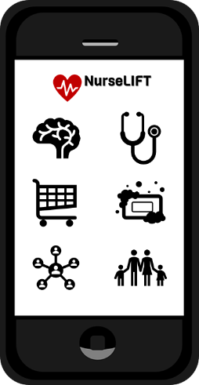
INTRODUCING NURSELIFT DIGITAL CONCIERGE
SOCIAL CONNECTION
HEALTH
MENTAL HEALTH
CONSUMER HEALTH
ESSENTIALS
FAMILY SUPPORT

Slide 4




IMPACT SUMMARY
I am RESILIENT
I am EMPOWERED
You’ll love it here
Better Patient Outcomes
Better Patient Care Experience
Better Patient Satisfaction
Decreased Turnover & Burnout
Improved Cost Efficiency
Increased Glass Door scores

Slide 5
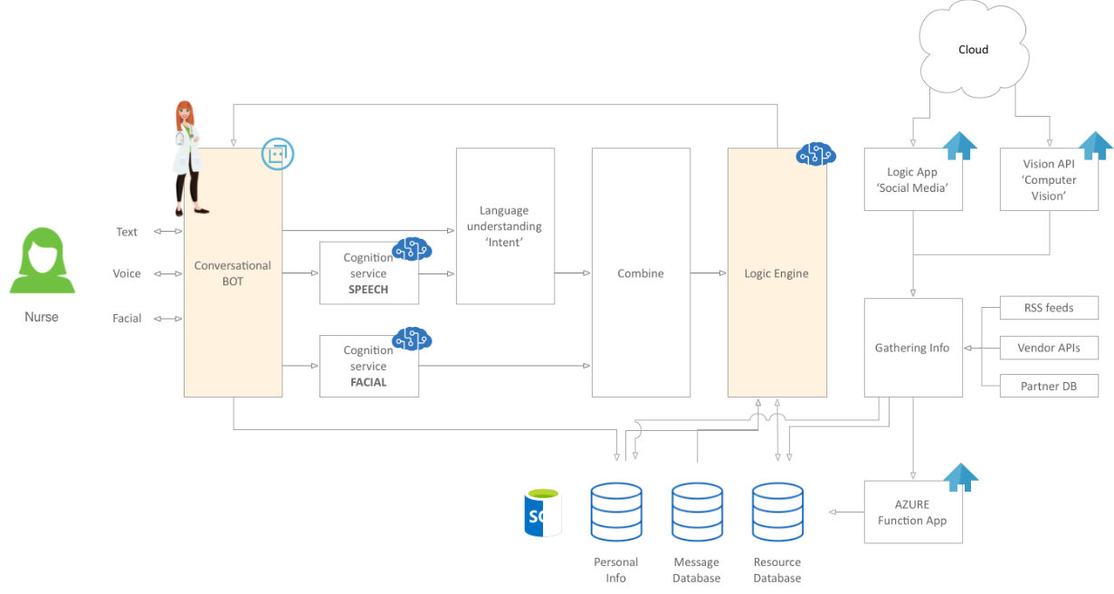
FUNCTIONAL ARCHITECTURE

Slide 6



GO-TO-MARKET PLAN
PILOT
Acute Care Nurses
10/20
WIN NH4H
Long Term Care Nurses
Other Front Line HCPs
Essential Workers
White Label
11/20
1/21
2/21

Slide 7

THANK YOU

Slide 8
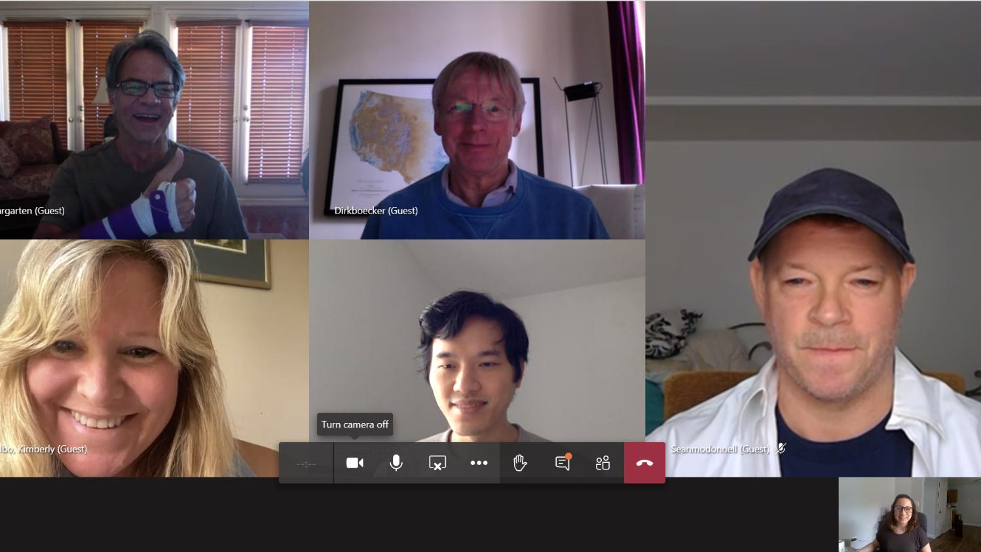

Slide 9

QUESTIONS?

